Slide 1


DON’T BE PHISHED!
Advanced phishing attack in Viet Nam
Analysis, Detection and Response
Viettel Threat Intelligence

Slide 2



@whoami
nghiant45@viettel.com.vn
Security Analyst at Viettel Threat Intelligence Center
@nghiant97

Slide 3


TABLE OF CONTENTS
01
Numbers
02
Analysis
03
Detection & Response
04
Conclusion

Slide 4



1. Numbers

Slide 5
Numbers
(data update 08/2022)
2191
~70
Domains/URLs
Organizations

Slide 6
Numbers

Slide 7






Numbers
65%
SMS Fake Brandname
Use topic of COVID-19
Impersonate the law enforcement officer
Target telecommunication
25%
10%

Slide 8
2. Analysis

Slide 9
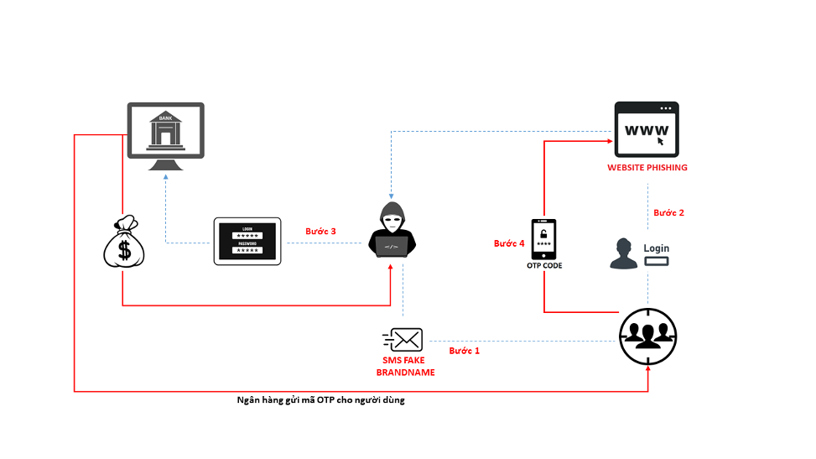
Phishing
Step 2
Step 3
Step 4
Step 1
Sending OTP code

Slide 10
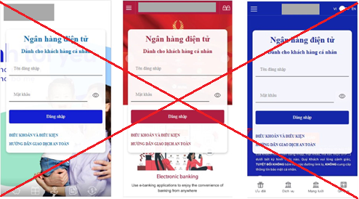

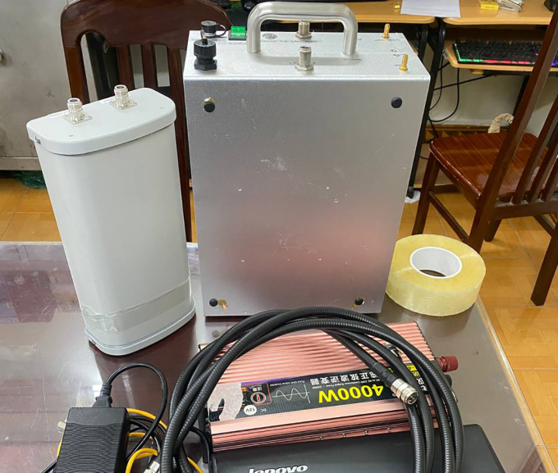
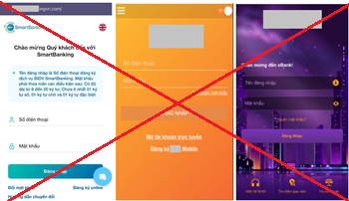
Prepare
Website phishing
Personal Data
IMSI Catcher/SMS Broadcaster

Slide 11
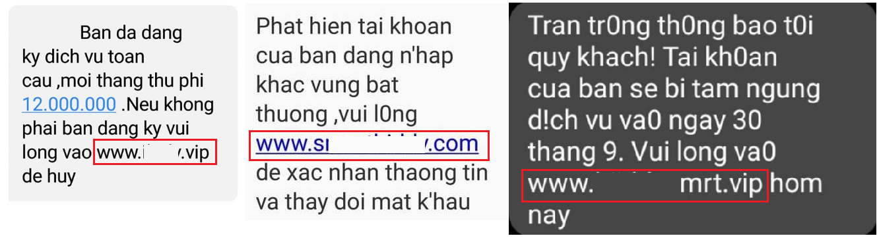

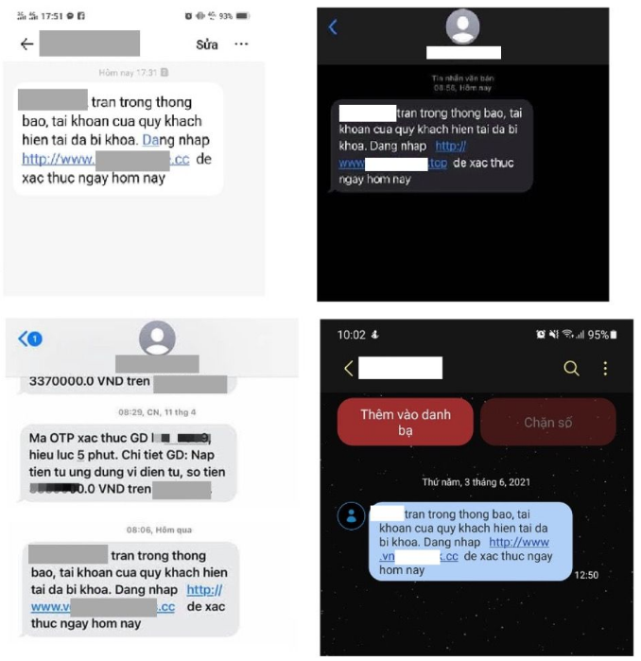
Let's go phishing !!!
70000 – 80000sms/day/device

Slide 12
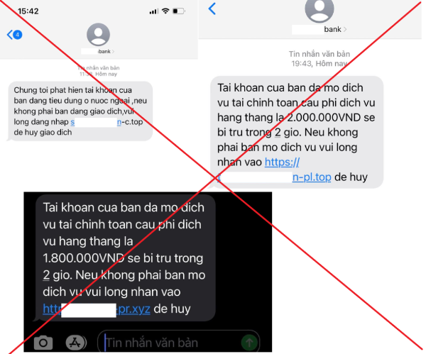
Case Study
Target: The finance and banking sector in Viet Nam
Use IMSI Catcher/SMS Broadcaster to send fake SMS
Timeline: 31/07/2022 - now
IOC: ~500 Domains & Subdomains

Slide 13
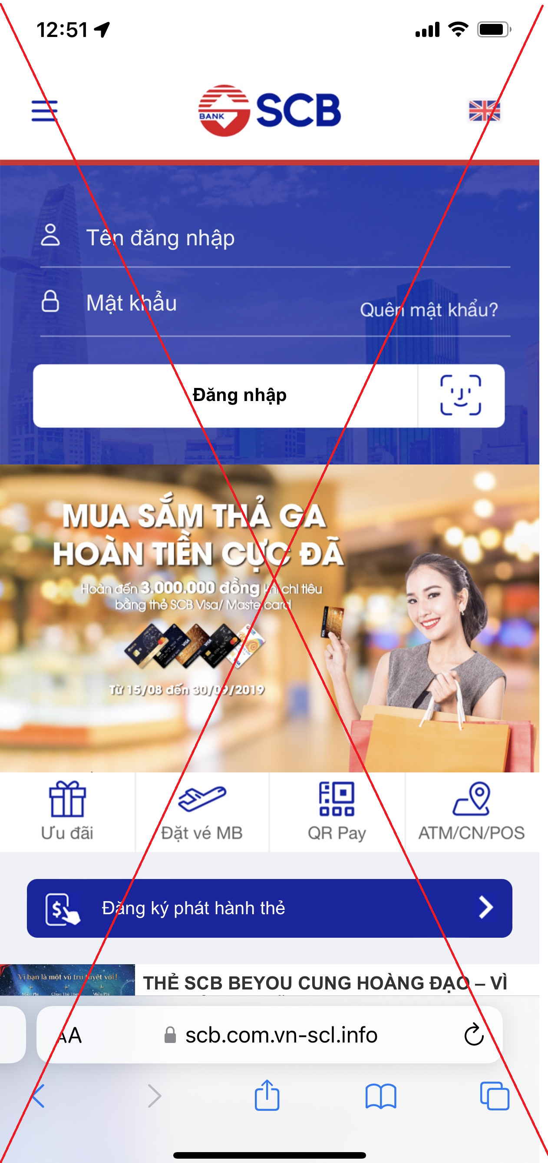
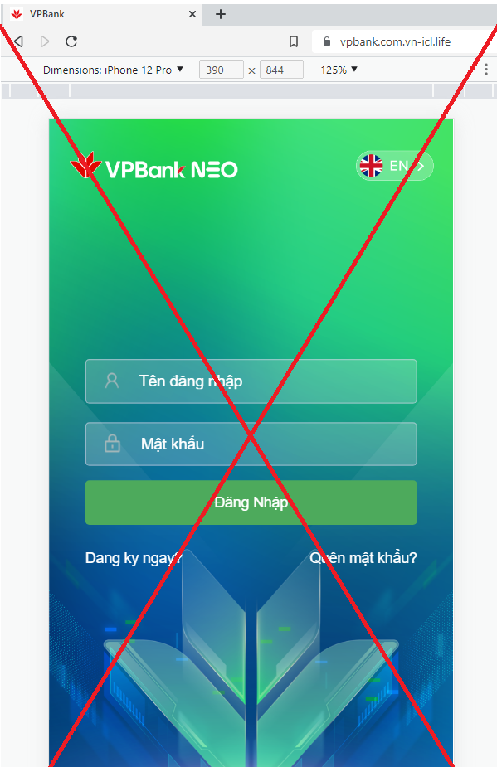
Case Study
Domain: vn-** (.xyz, .top, .life, .info, …)
Subdomain: [bank].vn-**, [bank].com.vn-**
Check mobile device
5-7 domains/day
Registrar: NameSilo LLC, GNAME.COM PTE. LTD

Slide 14
3. Detection & Response

Slide 15
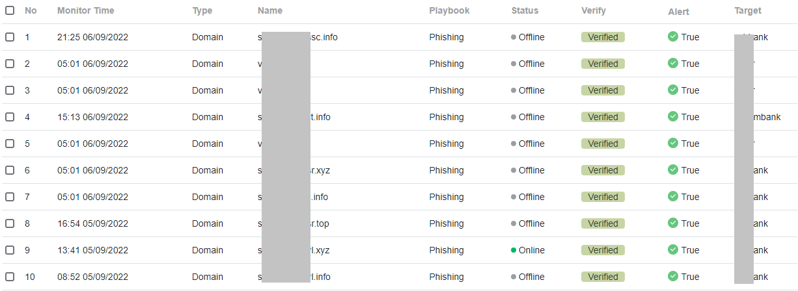
Detection
Data Collection
Processing
Monitoring
Report
Automatic detection of phishing

Slide 16




Detection
DNS
Processing
WHOIS
Storage
Monitor 24/7
Other

Slide 17

Response
For Organization:
Alert for customer
Monitor and Protect the company’s brand name
For Viettel Threat Intelligence:
Alert domains phishing/scam
Support to eliminate the domains.

Slide 18
4. Conclusion

Slide 19

Thank you for attention!!!

